Slide 1
“Hotel Booking Website”
Presented by:
Name: MD. Nayim ISLAM
ID: 193313007
Semester: 9th
batch: 6th
Project Supervisor:
md. Toufikul islam
Lecturer
Department of CSE
Varendra University

Slide 2
Introduction
The “HOTEL BOOKING WEBSITE” is a web based application that allows to handle all hotel activities in online.
Using the system we can :
View and booking room
Check room availability
Maintain their records
Staff management
Admin/Manager modify rooms in the system.

Slide 3
Project Aim And Objective
To room check-in and check-out in online.
To eliminate paper-work and save time.
Customer view room and then booked.
To lessen manager/admin work
To design a user friendly
.

Slide 4
Advantage Of The Developed System
Organizing and managing all data easily
No paper work
User Friendly
Computer operator control

Slide 5
Features
“HOTEL Booking Website” has been designed to computerize the following function that are Performed by the system:
Hotel Room Booking
Hotel Room Availability
Hotel Check-in and Check-out Function
Sign Up of New Customer
Statement of Customer Details
Management Reports

Slide 6
Structure Of The System
The system has mainly Two types of users and each user has its own login session to perform certain tasks.
The users are:-
Admin
Users

Slide 7
Structure Of The System (Cont’d..)
Admin:
Add/modify/delete/view Room information
Add/modify/delete/view Room images
Add/modify/delete/view Facilities
Add/modify/delete/view Features
Modify staffs information
View Customer information
Add/modify/delete/Contact information
Shutdown mode website

Slide 8
Structure Of The System (Cont’d..)
Users:
View Profile
View Rooms
View Facilities
View Features
Check-in and Check-out
Booked Room
Contact Us
Review & Rating
Online payment

Slide 9
Implementation
Tools:
Technologies:
XAMPP Software
Visual Studio Code Editor
Web Browser
HTML, CSS, AJAX, JavaScript Bootstrap as front end
PHP, MySQL as back end

Slide 10
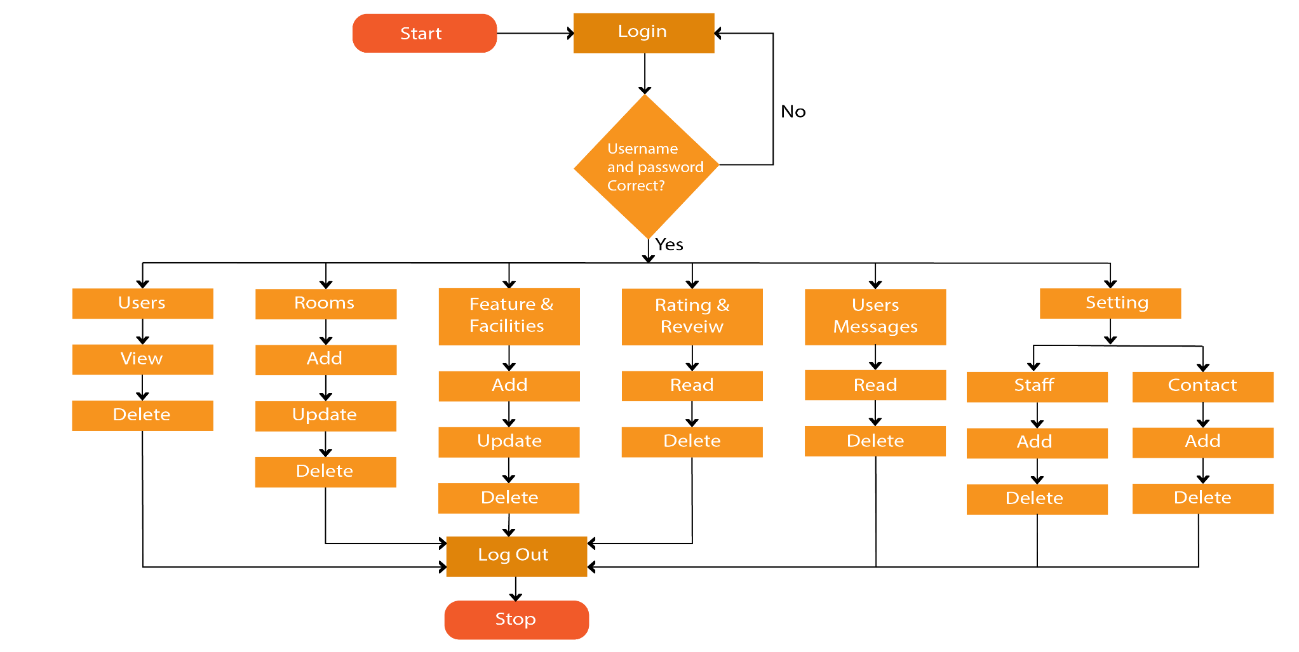
Flow-chart
Admin:

Slide 11
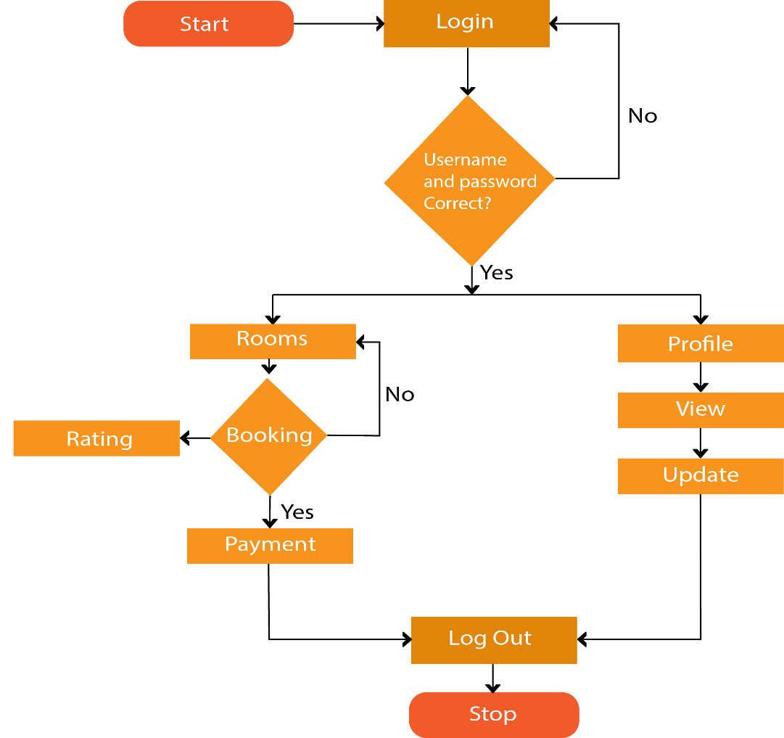
Flow-chart
Users:

Slide 12
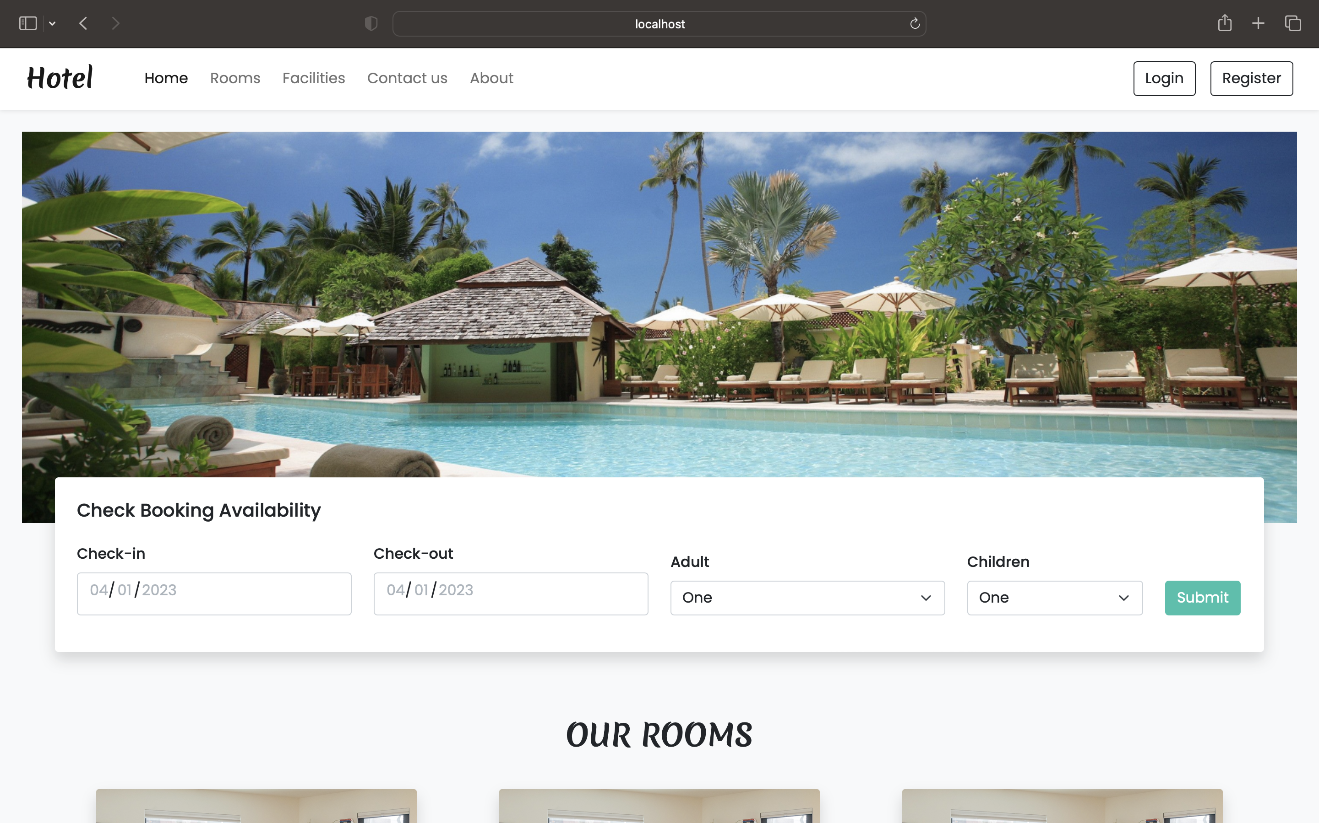
Home Page

Slide 13
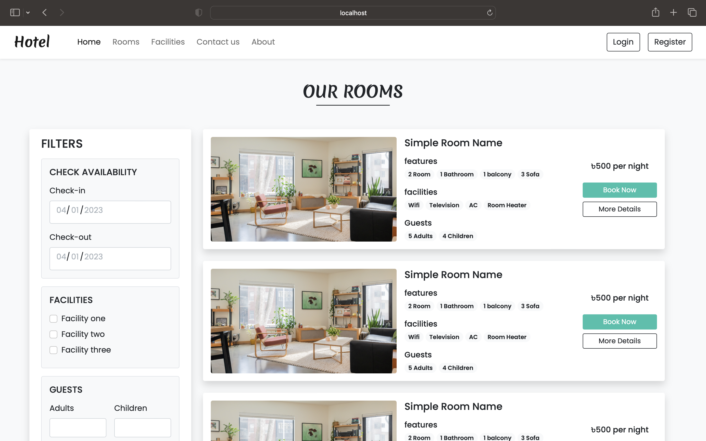
Room Page

Slide 14
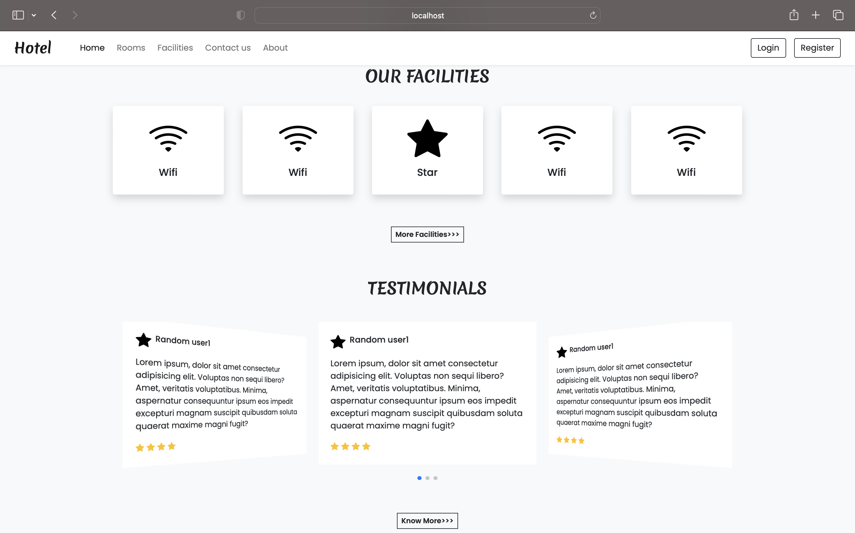
Testimonials & Facilities Page

Slide 15
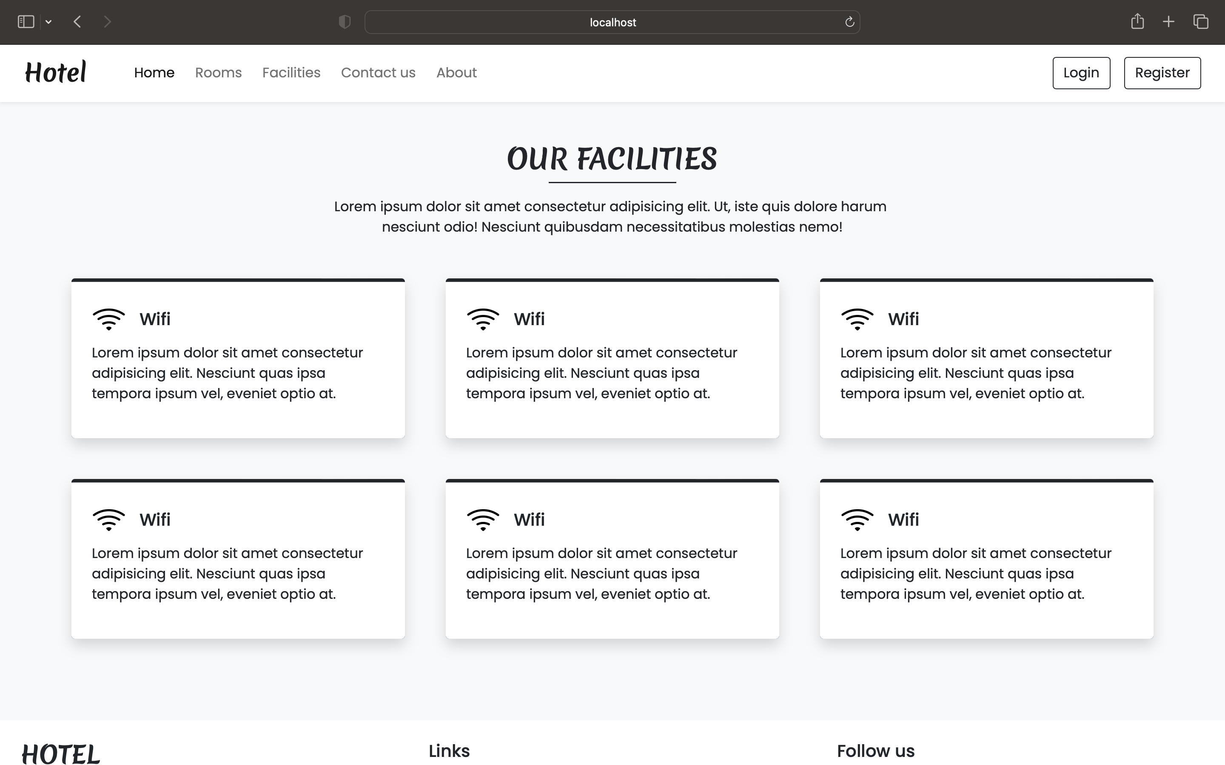
Facilities Page

Slide 16
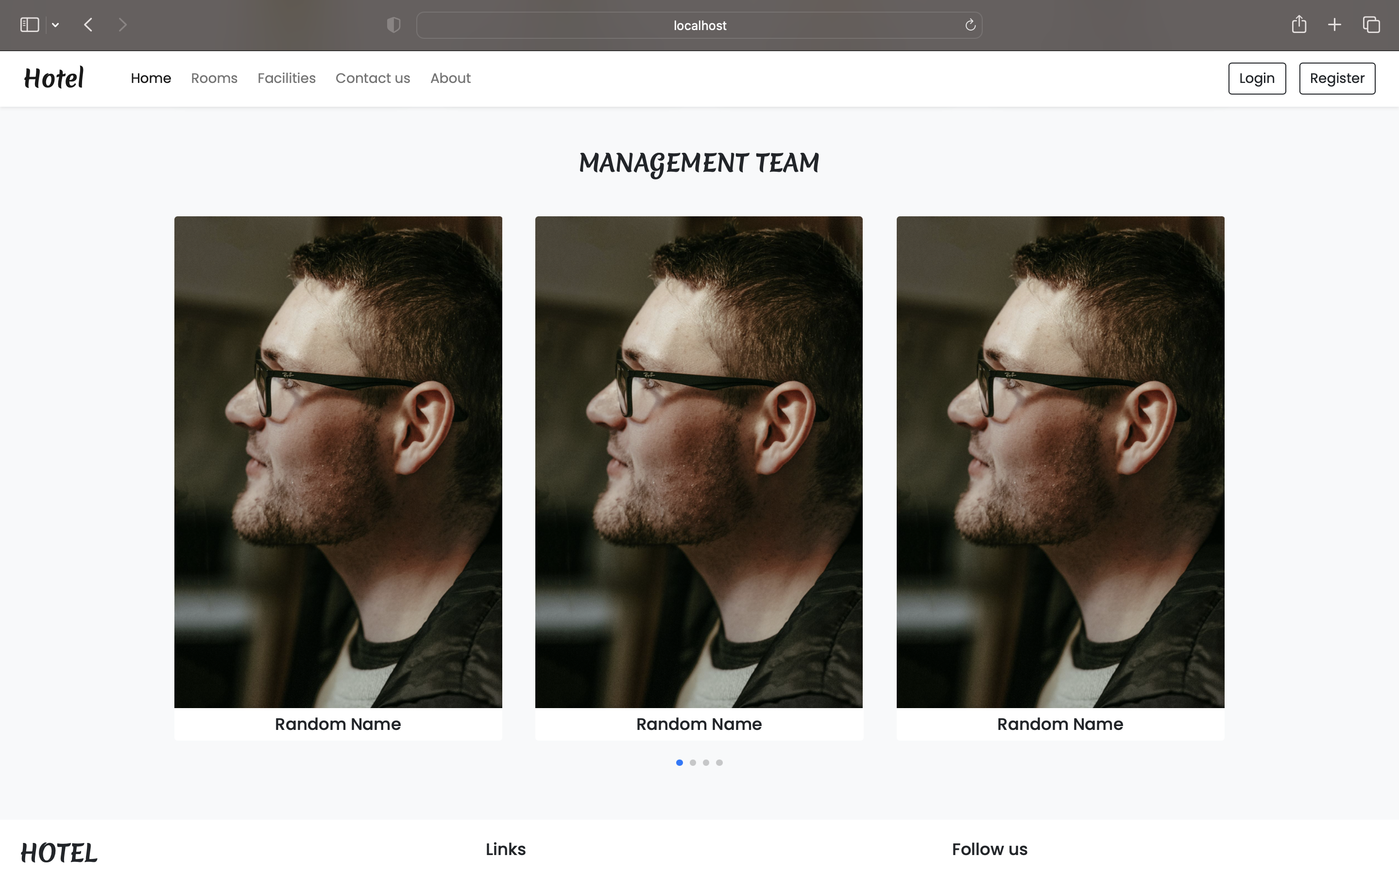
Management Team Page

Slide 17
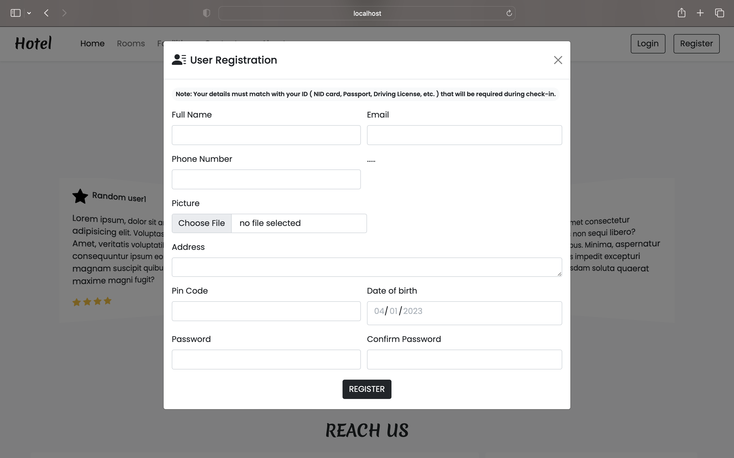
Login and Registration Form

Slide 18
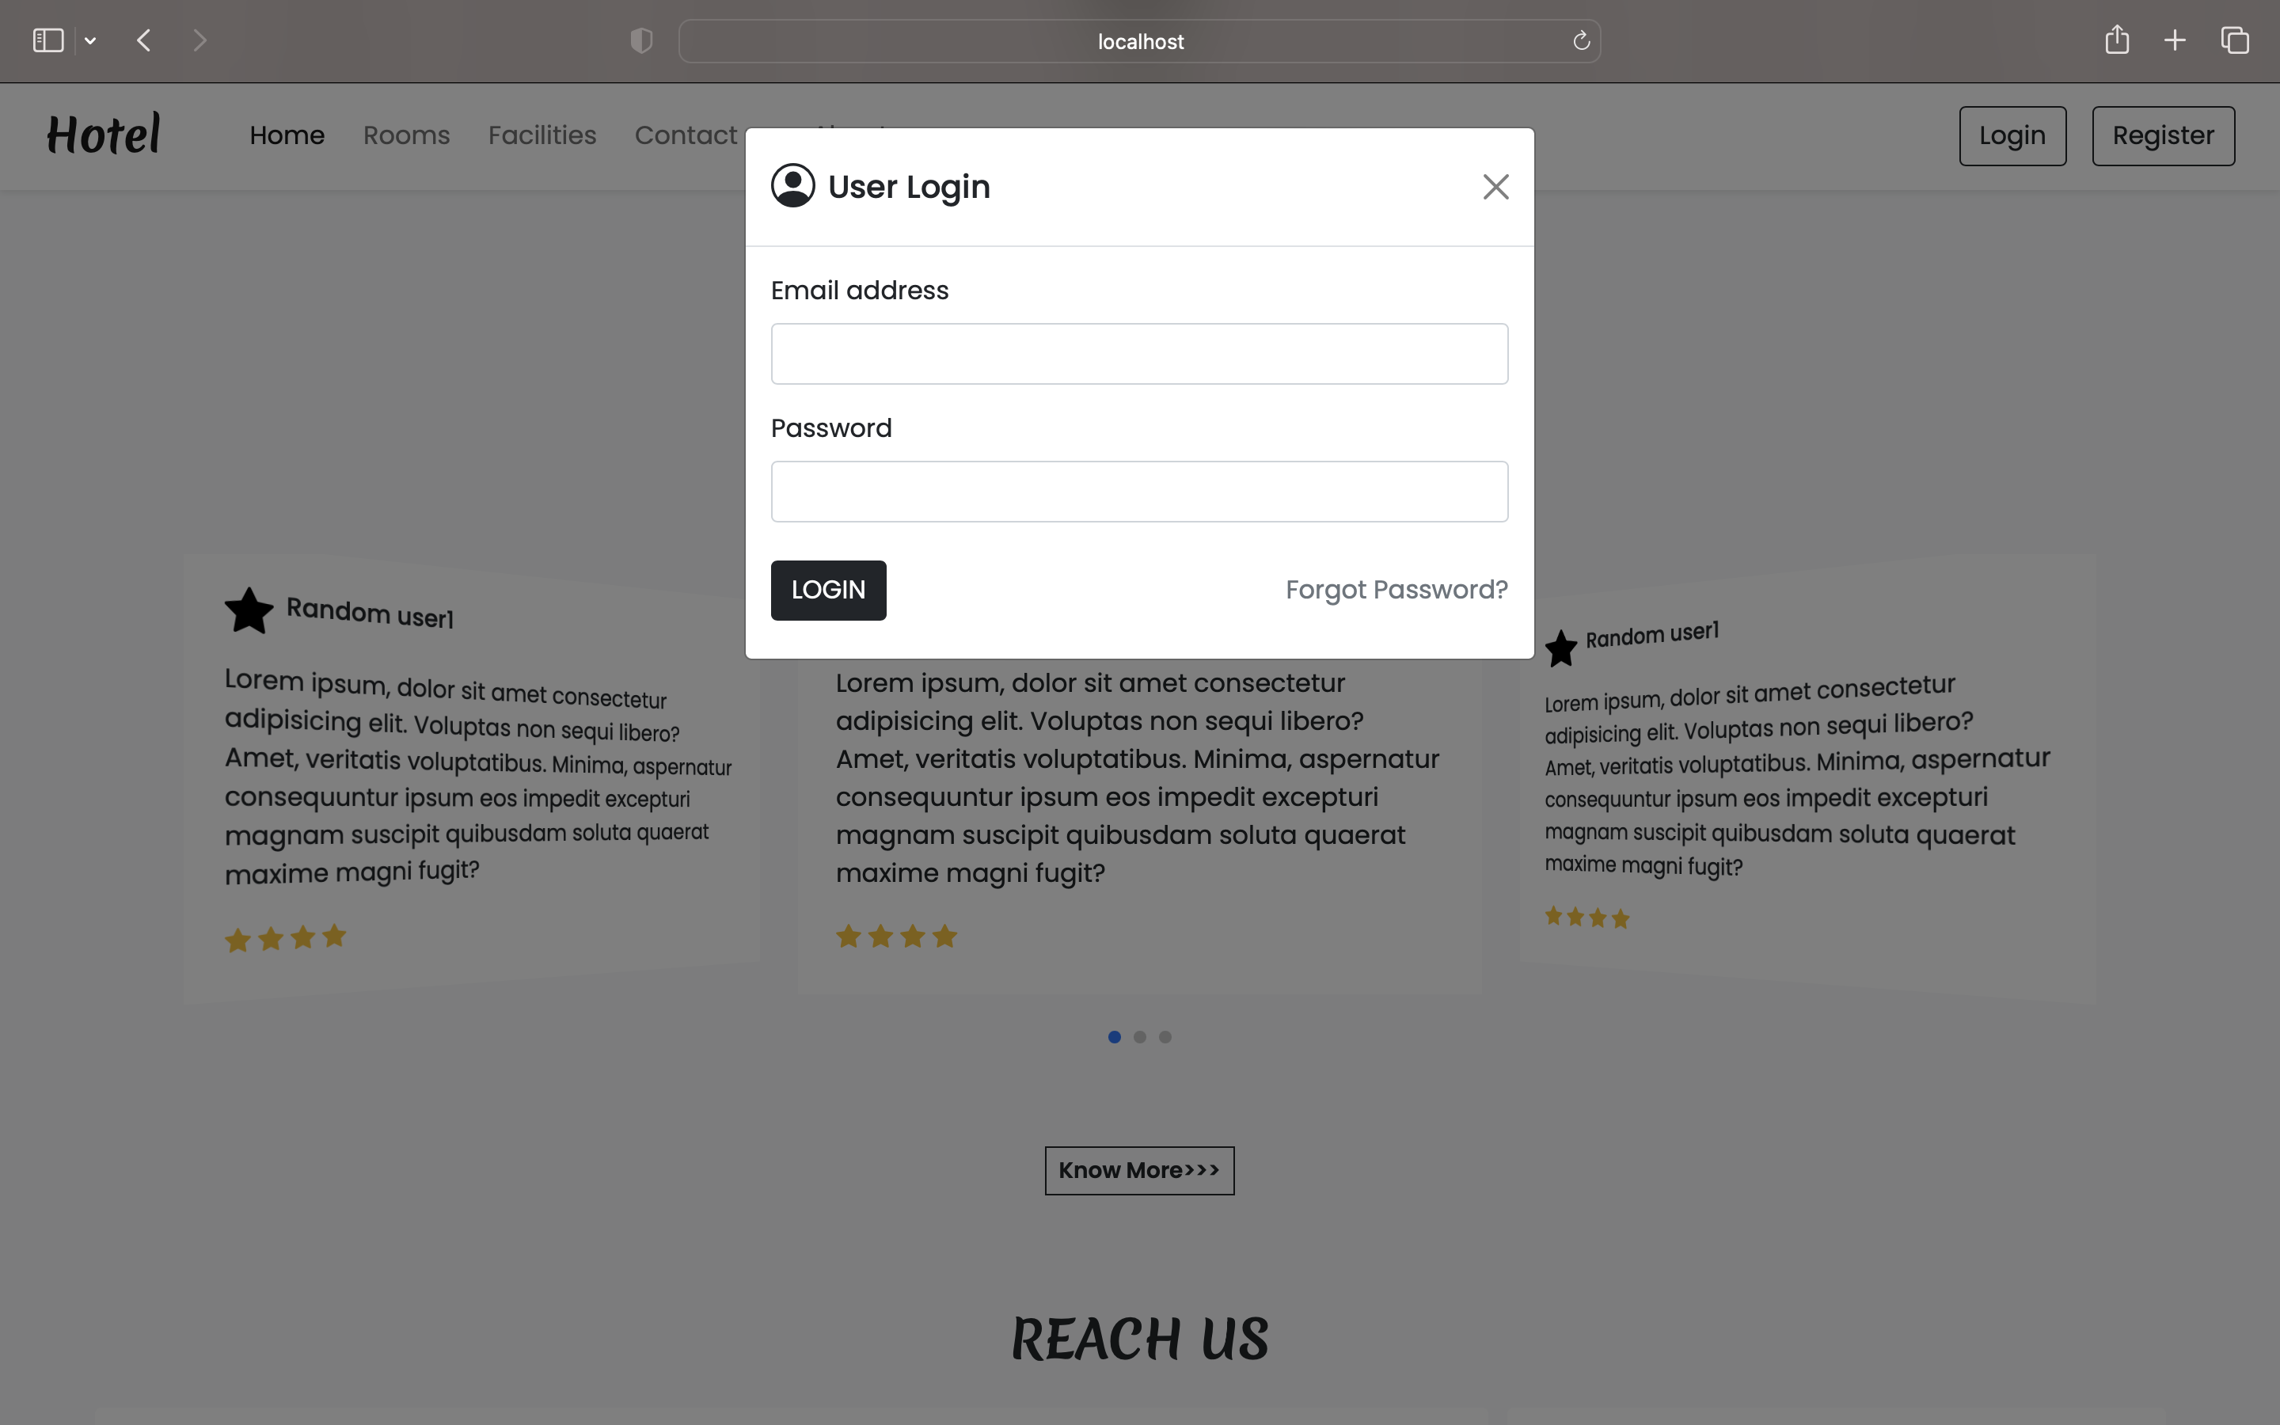
Login and Registration Form

Slide 19
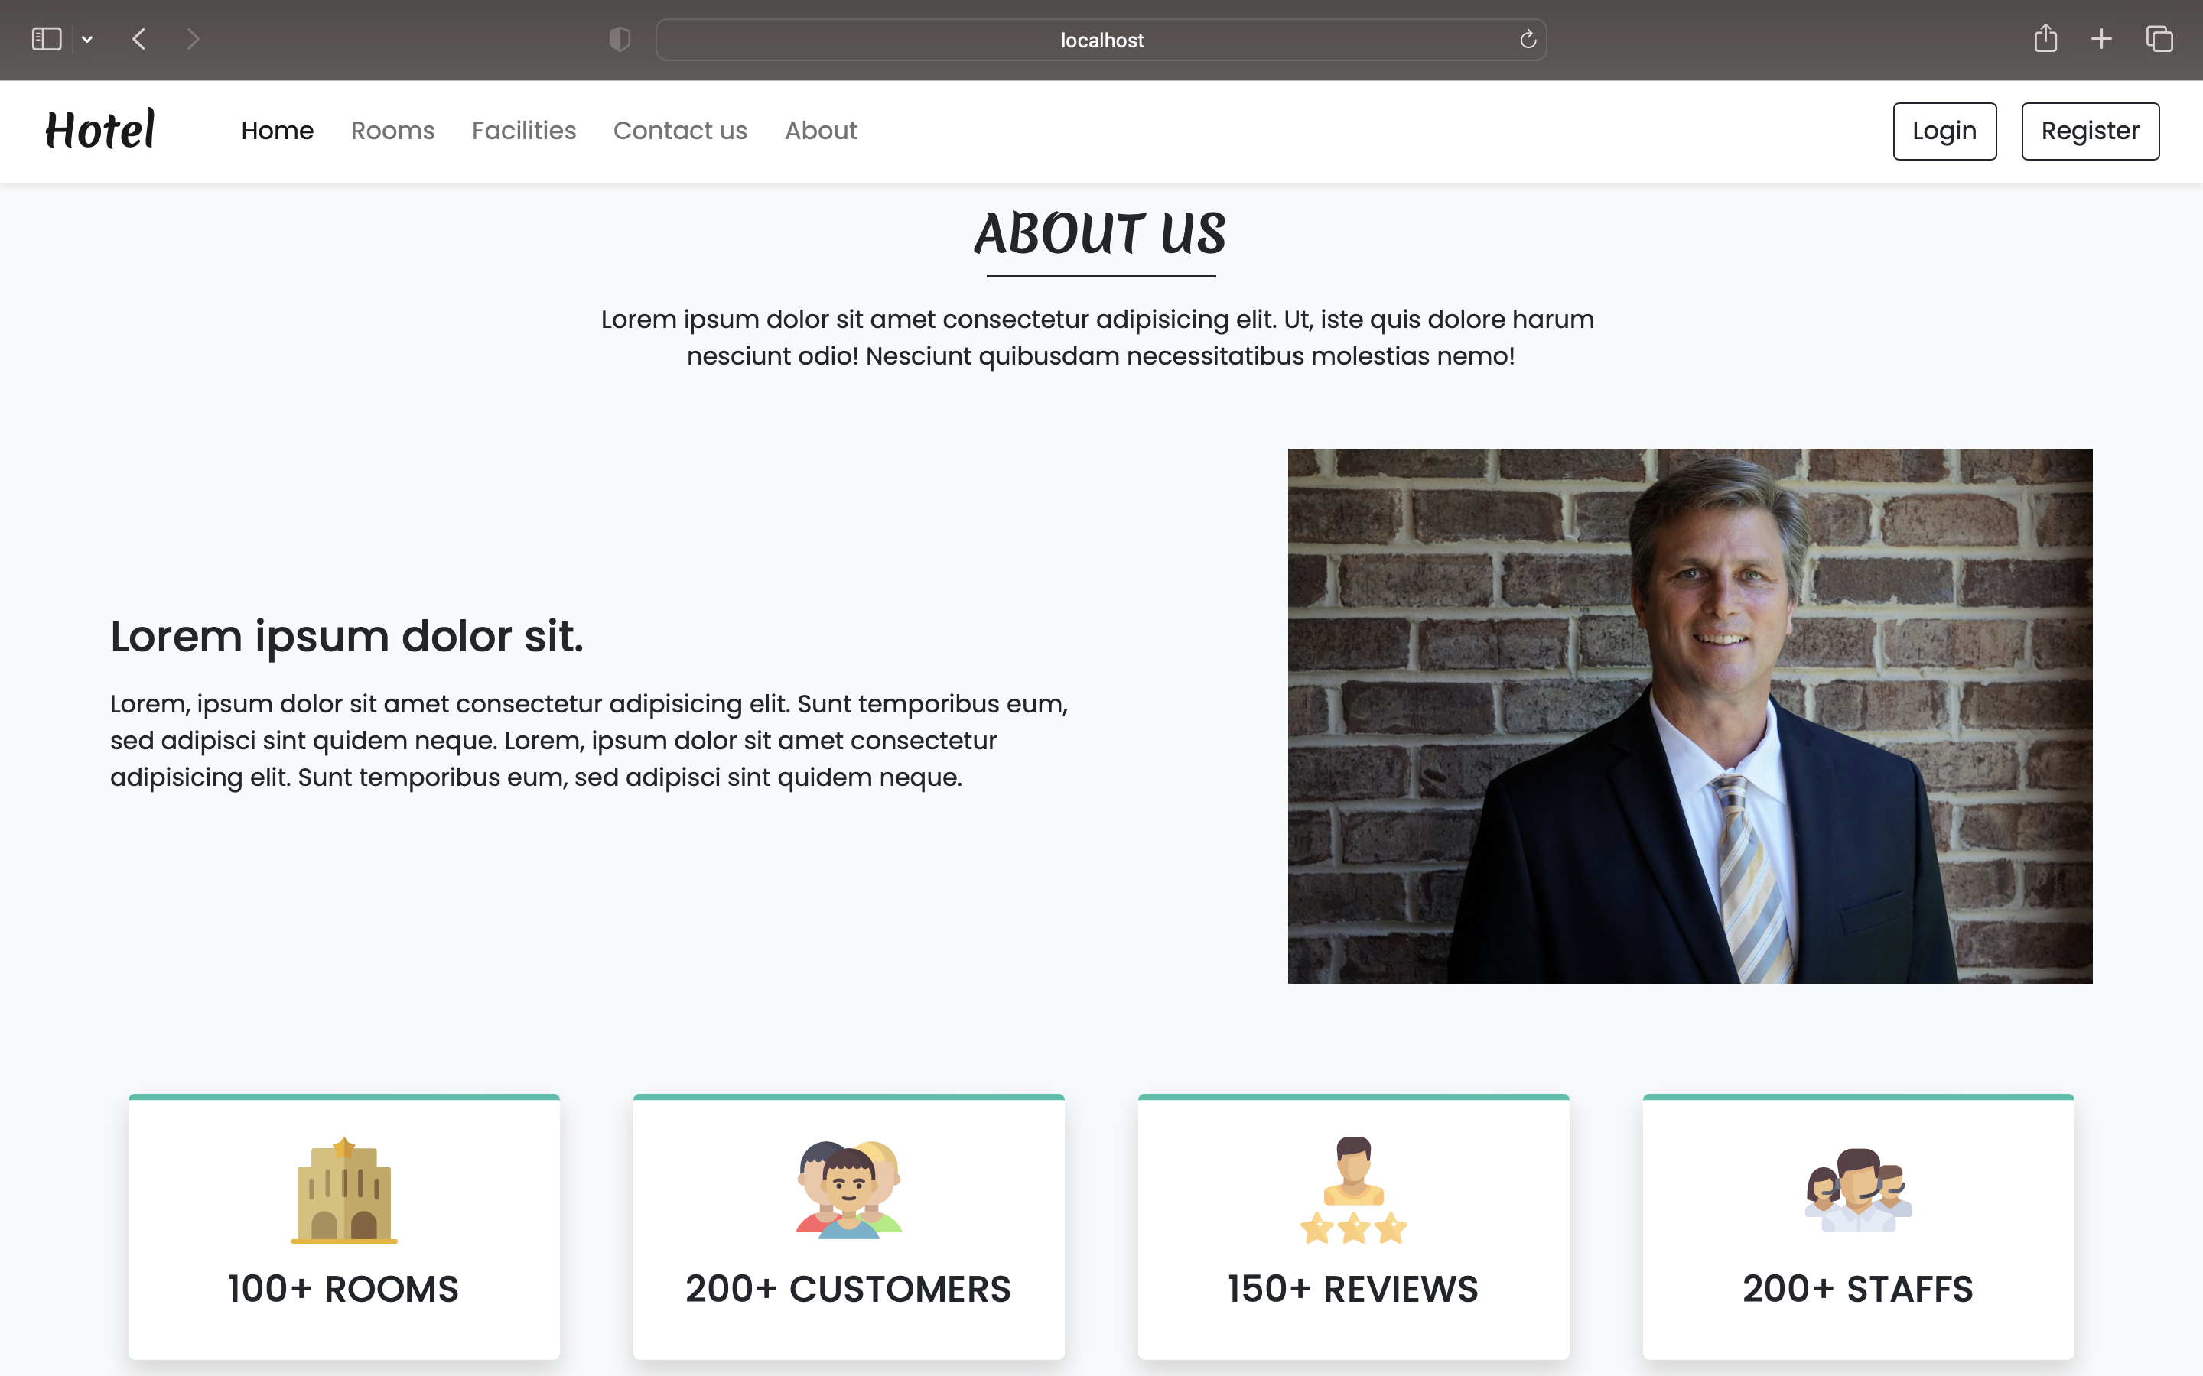
About Page

Slide 20
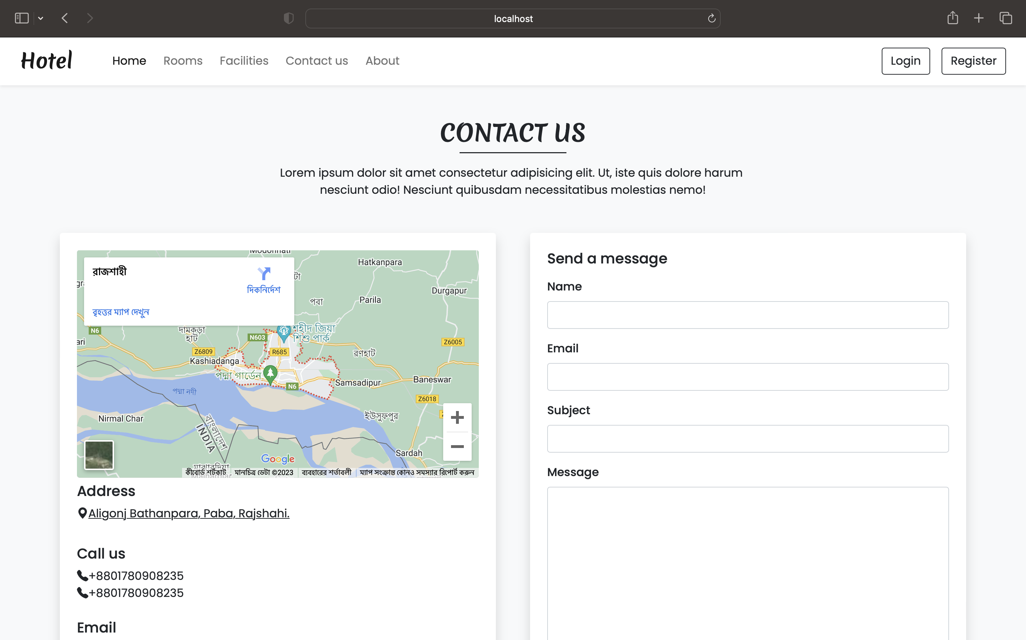
Contact Page

Slide 21
Conclusion
This System can take care of each member whether its Owner or Customer. This System will Help them to properly Manage their hotel and help in growth without creating any hassle.

Slide 22
Thank You

